Slide 1
Inventory;
Cost of Goods Sold (COGS); Working Capital

Slide 2
Inventory – overview
Acquisition – inventory is an asset:
When inventory is purchased or produced it is capitalized – recorded as an asset (no income effect initially).
Sale - the cost for inventory is recorded as Cost of goods sold (COGS) when the inventory is sold – matching principle.
The costing method used can materially affect both gross profit and the size of the balance sheet.

Slide 3
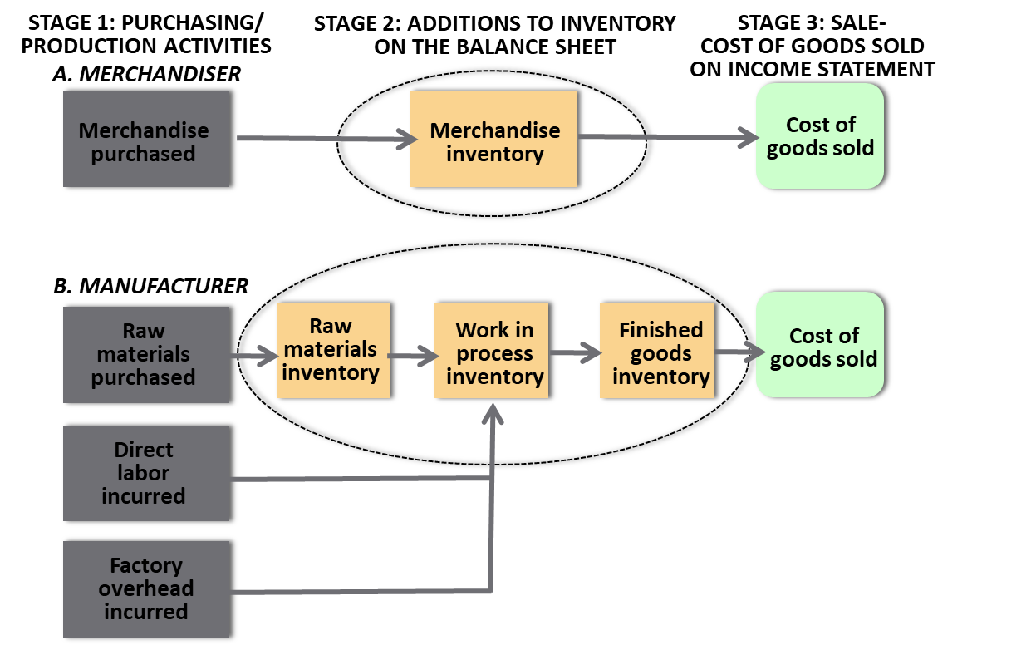
Inventory – by type

Slide 4
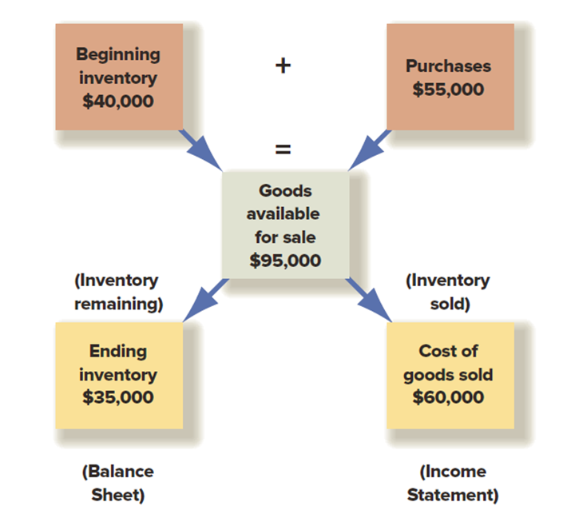
Inventory – cost flow and equation
Beginning Inventory
plus
Purchases
minus
Ending Inventory
equals to
COGS

Slide 5
Inventory – costing methods
Specific identification – tracking each high value item individually (for large, high value, unique items)
First-In, First-Out (FIFO) – first units in are first expensed
Last-In, First-Out (LIFO) – last units in are first expensed
Average cost – simple weighted average (interchangeable and difficult to identify items: agriculture, chemicals)

Slide 6
Inventory costing methods – effects
COGS, Profit, Income taxes, Ending Inventory:

Slide 7
Inventory – impairment
Lower of cost or market rule: carrying amount of inventory on the balance sheet cannot exceed its market value.
In case of a write-down:
The inventory value on the BS decreases
The amount of the write-down is recorded as an expense
Reasons: outdated technology (Blackberry), seasonality (Macy’s), spoilage (Beyond Meat), other reasons.

Slide 8
Inventory management – metrics
Inventory turnover = COGS / Avg Inventory
How many times the inventory has turned during the period
Days Inventory outstanding = Avg Inventory / Daily COGS
= 365 / Inventory turnover
How many days on average the inventory stays on the BS
Higher turnover = leaner inventory, but may risk stock-outs

Slide 9
Working Capital Management

Slide 10
Working capital – definition
Working capital is defined as the capital needed to ensure smooth operating cycle.
Net working capital (NWC) is calculated as the difference between the current operating assets (AR, Inventory) and the current operating liabilities (AP):
NWC = AR + Inventory - AP

Slide 11
Working capital – metrics
Shows how long cash is tied up between paying suppliers and collecting from customers.
Working capital in days or Cash Conversion Cycle =
Days Sales Outstanding plus
Days Inventory outstanding minus
Days AP outstanding

Slide 12
Working capital management
Effective management of working capital:
Reflects the optimal tradeoff between liquidity (cash availability) and profit and sales growth.
Can be crucial to investment decisions.
Varies widely by industry.
Varies widely by company’s age and business model.

